Slide 1

Machine Learning
ICT-4261
By-
Dr. Jesmin Akhter
Professor
Institute of Information Technology
Jahangirnagar University

Slide 2
Contents
Naive Bayes
Support Vector Machines
The course will mainly cover the following topics:
A Gentle Introduction to Machine Learning
Linear Regression
Logistic Regression
Naive Bayes
Support Vector Machines
Decision Trees and Ensemble Learning
Clustering Fundamentals
Hierarchical Clustering
Neural Networks and Deep Learning
Unsupervised Learning

Slide 3
Outline
Logistic Regression
Gradient Descent
Linear regression vs logistic regression
Types of logistic regression
Key properties of the logistic regression equation
Stochastic gradient descent algorithms
Linear classification
Notes:
https://www.javatpoint.com/regression-analysis-in-machine-learning

Slide 4
Gradient Descent
Gradient descent is an iterative process and in each step, it tries to move down the slope and get closer to the local minimum through which we optimize the parameters of a machine learning model. It’s particularly used in neural networks, but also in logistic regression and support vector machines.
It’s the most typical method for iterative minimization of a cost function. Its major limitation, though, consists of its guaranteed convergence to a local, not necessarily global, minimum:

Slide 5

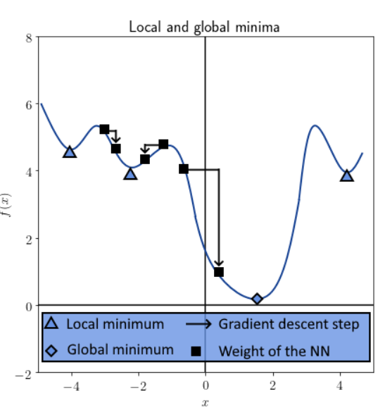
Gradient Descent
The gradient is calculated with respect to a vector of parameters for the model, typically the weights theta
The sign of the gradient allows us to decide the direction of the closest minimum to the cost function. For a given parameter , we iteratively optimize the vector by computing:
And this is the graphical representation

Slide 6
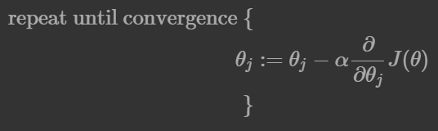
Gradient Descent
At step j , the weights are all modified by the product of the hyperparameter alpha times the gradient of the cost function, computed with those weights. If the gradient is positive, then we decrease the weights; and conversely, if the gradient is negative, then we increase them.
we can summarize the Gradient Descent Algorithm as:
Start with random
Loop until convergence:
Compute Gradient
Update
Return

Slide 7
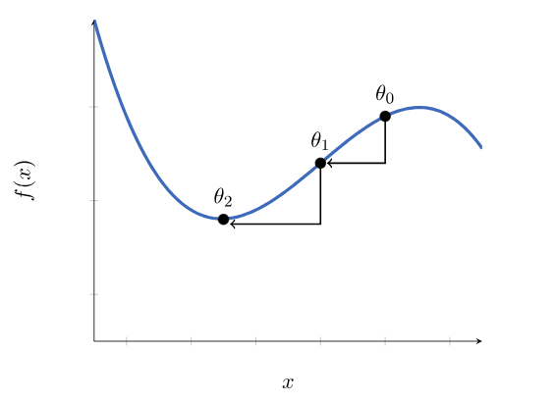

Minimizing the Cost with Gradient Descent
How gradient descent, can iteratively approximate the local minimum of a function with an arbitrary degree of precision?
We start with identifying a starting point that is sufficient proximity to the function’s local minimum, in this case,
Then, iteratively, we move towards the closest local minimum by exploiting the gradient of the function around

Slide 8

Minimizing the Cost with Gradient Descent
Gradient descent is an iterative optimization algorithm, which finds the minimum of a differentiable function. In this process, we try different values and update them to reach the optimal ones, minimizing the output.
we can apply this method to the cost function of logistic regression. This way, we can find an optimal solution minimizing the cost over model parameters:
We’re using the sigmoid function as the hypothesis function in logistic regression.
Assume we have a total of n features. In this case, we have n parameters for the theta vector. To minimize our cost function, we need to run the gradient descent on each parameter :

Slide 9

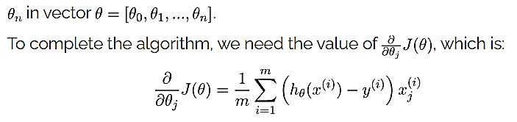
Minimizing the Cost with Gradient Descent
Furthermore, we need to update each parameter simultaneously for each iteration in the direction that decreases the cost function. In other words, we need to loop through the parameters
Plugging this into the gradient descent function leads to the update rule:
Surprisingly, the update rule is the same as the one derived by using the sum of the squared errors in linear regression. As a result, we can use the same gradient descent formula for logistic regression as well.
By iterating over the training samples until convergence, we reach the optimal parameters theta leading to minimum cost.
In the case of logistic regression, analogously, we use a cost function that contains a logarithmic expression and we apply gradient descent algorithm on it.

Slide 10
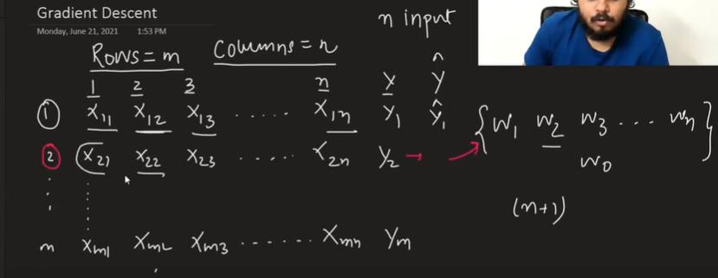
Derive the loss function with matrix form

Slide 11
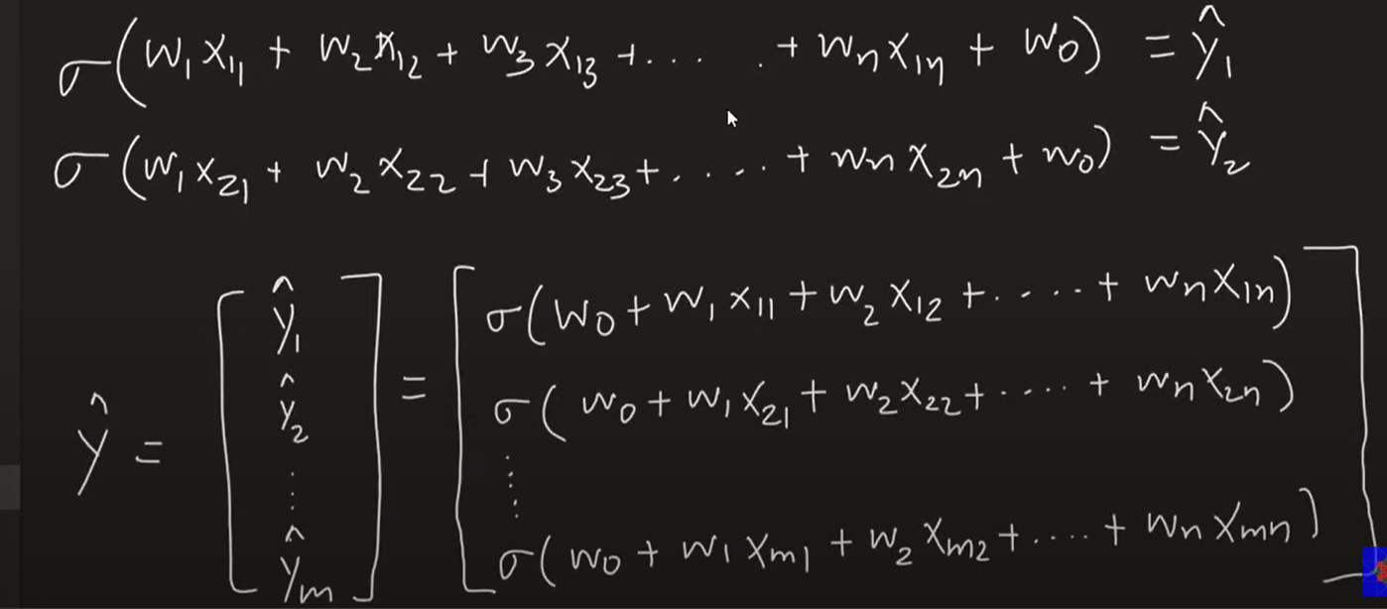

Slide 12
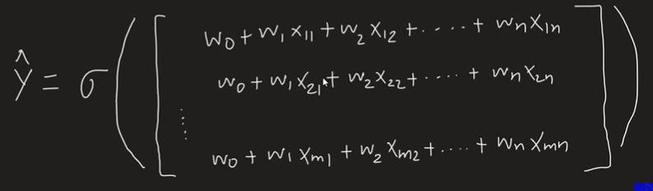
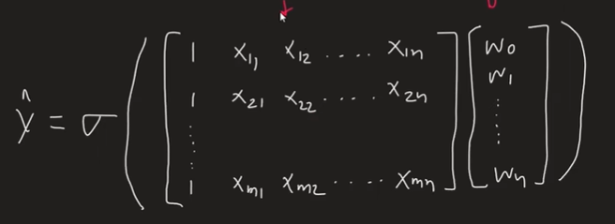

Slide 13
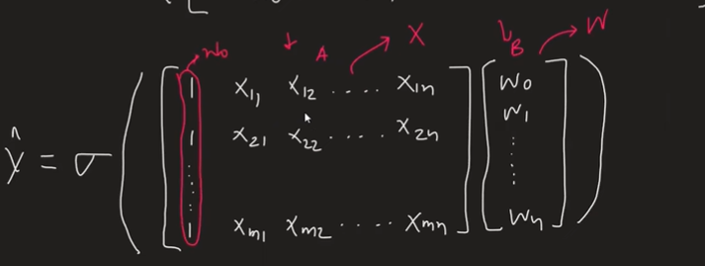
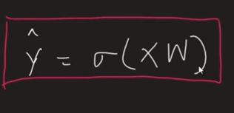

Slide 14
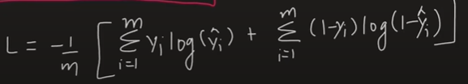
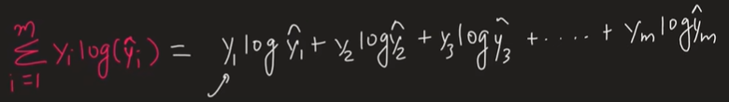
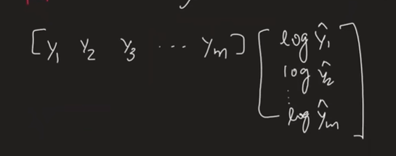
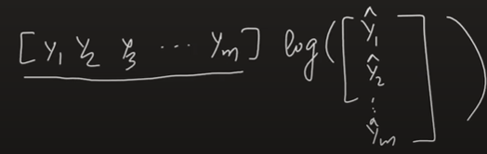
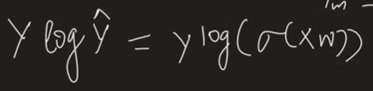
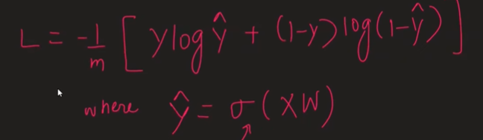

Slide 15
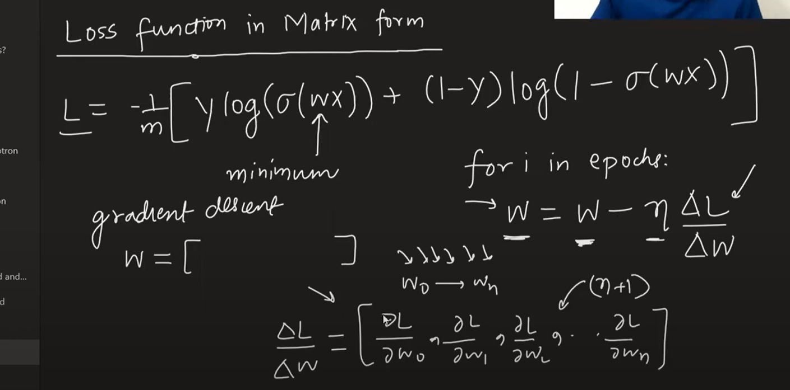

Slide 16
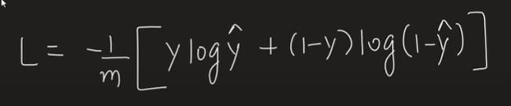
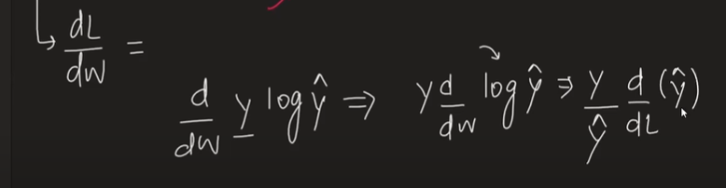
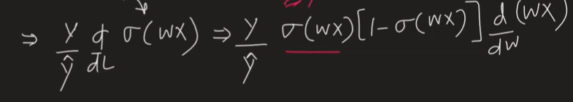
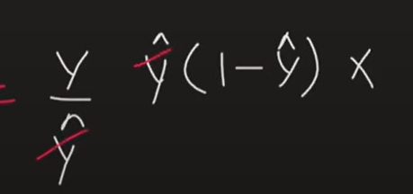
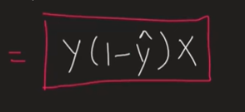

Slide 17
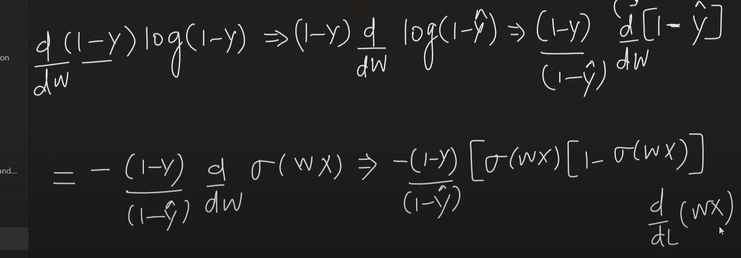
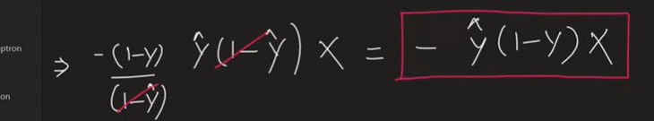

Slide 18
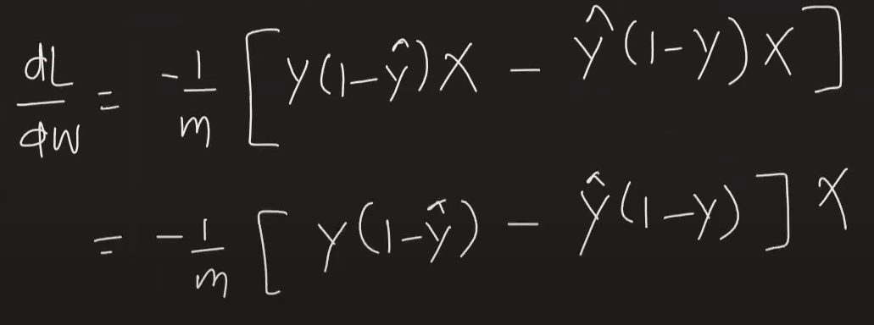
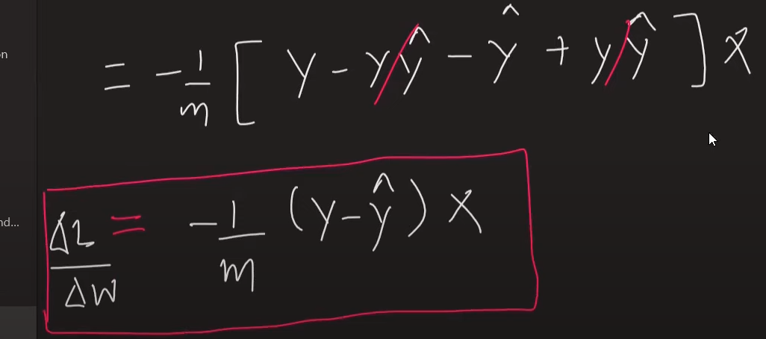

Slide 19
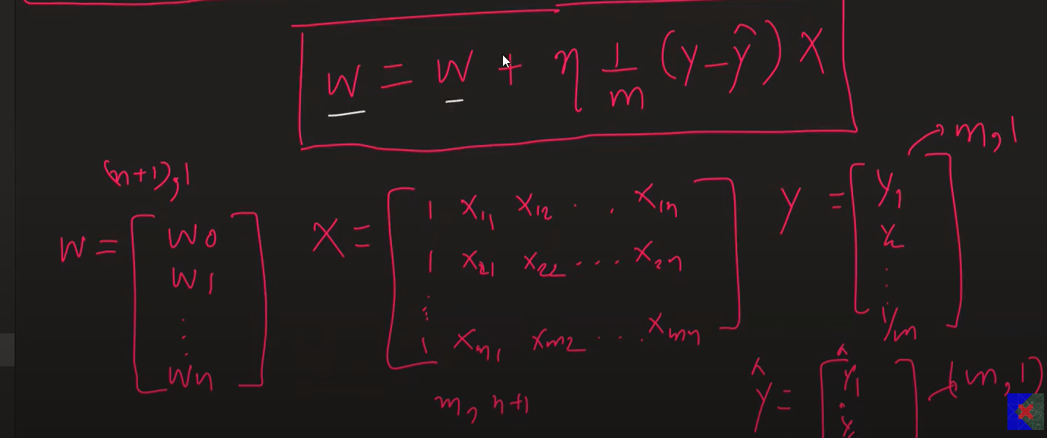

Slide 20
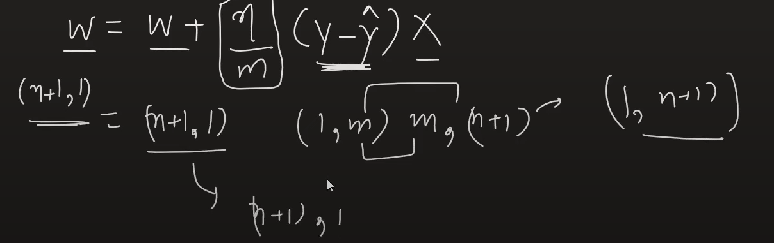

Slide 21
Linear regression vs logistic regression
Sr. No | Linear Regresssion | Logistic Regression
1 | Linear regression is used to predict the continuous dependent variable using a given set of independent variables. | Logistic regression is used to predict the categorical dependent variable using a given set of independent variables.
2 | Linear regression is used for solving Regression problem. | It is used for solving classification problems.
3 | The relationship between the dependent variable and independent variable must be linear. | The relationship DOES NOT need to be linear between the dependent and independent variables.
4 | We are finding and using the line of best fit to help us easily predict outputs. | We are using the S-curve (Sigmoid) to help us classify predicted outputs.
5 | Least square estimation method is used for estimation of accuracy. | Maximum likelihood estimation method is used for Estimation of accuracy.
6 | The output must be continuous value,such as price,age,etc. | Output is must be categorical value such as 0 or 1, Yes or no, etc.
7 | There is a possibility of collinearity between the independent variables. | There should not be any collinearity between the independent variable.
Notes:
In regression problems, the goal is to approximate a mapping function from input variables to a continuous output variable
collinearity, in statistics, correlation between predictor variables or independent variables, such that they express a linear relationship in a regression model. When predictor variables in the same regression model are correlated, they cannot independently predict the value of the dependent variable.

Slide 22
Some Examples
Some examples of such classifications and instances where the binary response is expected or implied are:
Fraud detection: Logistic regression models can help teams identify data anomalies, which are predictive of fraud. Certain behaviors or characteristics may have a higher association with fraudulent activities, which is particularly helpful to banking and other financial institutions in protecting their clients..
Disease prediction: In medicine, this analytics approach can be used to predict the likelihood of disease or illness for a given population. Healthcare organizations can set up preventative care for individuals that show higher tendency for specific illnesses.
Determine the probability of heart attacks: With the help of a logistic model, medical practitioners can determine the relationship between variables such as the weight, exercise, etc., of an individual and use it to predict whether the person will suffer from a heart attack or any other medical complication.

Slide 23
Some Examples
Possibility of enrolling into a university: Application aggregators can determine the probability of a student getting accepted to a particular university or a degree course in a college by studying the relationship between the estimator variables, such as GRE, GMAT, or TOEFL scores.
Identifying spam emails: Email inboxes are filtered to determine if the email communication is promotional/spam by understanding the predictor variables and applying a logistic regression algorithm to check its authenticity.

Slide 24
Types of logistic regression
There are three types of logistic regression models, which are defined based on categorical response.
Binary logistic regression
Multinomial logistic regression
Ordinal logistic regression
Binary logistic regression
In this approach, the response or dependent variable is dichotomous in nature—i.e. it has only two possible outcomes (e.g. success/failure, 0/1, or true/false). Within logistic regression, it is one of the most common classifiers for binary classification.
Some popular examples of its use include
predicting if an e-mail is spam or not spam or if a tumor is malignant or not malignant.
Deciding on whether or not to offer a loan to a bank customer: Outcome = yes or no.
Evaluating the risk of cancer: Outcome = high or low.
Predicting a team’s win in a football match: Outcome = yes or no.

Slide 25
Types of logistic regression
Multinomial logistic regression
A categorical dependent variable has three or more discrete outcomes in a multinomial regression type. This implies that this regression type has more than two possible outcomes.
; however, these values have no specified order such as "cat", "dogs", or "sheep“
Examples:
Let’s say you want to predict the most popular transportation type for 2040. Here, transport type equates to the dependent variable, and the possible outcomes can be electric cars, electric trains, electric buses, and electric bikes.
Predicting whether a student will join a college, vocational/trade school, or corporate industry.
Estimating the type of food consumed by pets, the outcome may be wet food, dry food, or junk food.
Notes:
Genre-a style or category of art, music

Slide 26
Types of logistic regression
Ordinal logistic regression
This type of logistic regression model is applied when the response variable has three or more possible outcome, but in this case, these values do have a defined order.
Examples: Ordered types of dependent variables represent,
"low", "Medium", or "High“, grading scales from A to F or rating scales from 1 to 5.
Formal shirt size: Outcomes = XS/S/M/L/XL
Survey answers: Outcomes = Agree/Disagree/Unsure
Scores on a math test: Outcomes = Poor/Average/Good
Notes:
Genre-a style or category of art, music
Leverage-maximum advantage.

Slide 27
Key Advantages of Logistic Regression
1. Easier to implement machine learning methods: A machine learning model can be effectively set up with the help of training and testing. The training identifies patterns in the input data (image) and associates them with some form of output (label). Training a logistic model with a regression algorithm does not demand higher computational power. As such, logistic regression is easier to implement, interpret, and train than other ML methods.
2. Suitable for linearly separable datasets: A linearly separable dataset refers to a graph where a straight line separates the two data classes. In logistic regression, the y variable takes only two values. Hence, one can effectively classify data into two separate classes if linearly separable data is used.
3. Provides valuable insights: Logistic regression measures how relevant or appropriate an independent/predictor variable is (coefficient size) and also reveals the direction of their relationship or association (positive or negative).

Slide 28
Key properties of the logistic regression equation
Typical properties of the logistic regression equation include:
Logistic regression’s dependent variable obeys ‘Bernoulli distribution’
Estimation/prediction is based on ‘maximum likelihood.’
Logistic regression does not evaluate the coefficient of determination (or R squared) as observed in linear regression’. Instead, the model’s fitness is assessed through a concordance.
For example, KS or Kolmogorov-Smirnov statistics look at the difference between cumulative events and cumulative non-events to determine the efficacy of models through credit scoring.

Slide 29
Key properties of the logistic regression equation
While implementing logistic regression, one needs to keep in mind the following key assumptions:
1. The dependent/response variable is binary or dichotomous
The first assumption of logistic regression is that response variables can only take on two possible outcomes – pass/fail, male/female, and malignant/benign.
This assumption can be checked by simply counting the unique outcomes of the dependent variable. If more than two possible outcomes surface, then one can consider that this assumption is violated.
2. Little or no multicollinearity between the predictor/explanatory variables
This assumption implies that the predictor variables (or the independent variables) should be independent of each other. Multicollinearity relates to two or more highly correlated independent variables. Such variables do not provide unique information in the regression model and lead to wrongful interpretation.
The assumption can be verified with the variance inflation factor (VIF), which determines the correlation strength between the independent variables in a regression model.

Slide 30
Key properties of the logistic regression equation
3. Linear relationship of independent variables to log odds
Log odds refer to the ways of expressing probabilities. Log odds are different from probabilities. Odds refer to the ratio of success to failure, while probability refers to the ratio of success to everything that can occur.
For example, consider that you play twelve tennis games with your friend. Here, the odds of you winning are 5 to 7 (or 5/7), while the probability of you winning is 5 to 12 (as the total games played = 12).
the order of observations. The plot helps in determining the presence or absence of a random pattern. If a random pattern is present or detected, this assumption may be considered violated.

Slide 31
Key properties of the logistic regression equation
4. Prefers large sample size
Logistic regression analysis yields reliable, robust, and valid results when a larger sample size of the dataset is considered.
This assumption can be validated by taking into account a minimum of 10 cases considering the least frequent outcome for each estimator variable. Let’s consider a case where you have three predictor variables, and the probability of the least frequent outcome is 0.30. Here, the sample size would be (10*3) / 0.30 = 100.
5. Problem with extreme outliers
Another critical assumption of logistic regression is the requirement of no extreme outliers in the dataset.
This assumption can be verified by calculating Cook’s distance (Di) for each observation to identify influential data points that may negatively affect the regression model. In situations when outliers exist, one can implement the following solutions:
Eliminate or remove the outliers
Consider a value of mean or median instead of outliers, or
Keep the outliers in the model but maintain a record of them while reporting the regression results
Notes:
Outliers are those data points that are significantly different from the rest of the dataset. They are often abnormal observations

Slide 32
Key properties of the logistic regression equation
6. Consider independent observations
This assumption states that the dataset observations should be independent of each other. The observations should not be related to each other or emerge from repeated measurements of the same individual type.
The assumption can be verified by plotting residuals against time, which signifies the order of observations. The plot helps in determining the presence or absence of a random pattern. If a random pattern is present or detected, this assumption may be considered violated.

Slide 33
Thank You

Slide 34

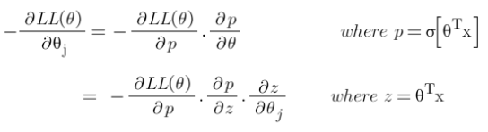
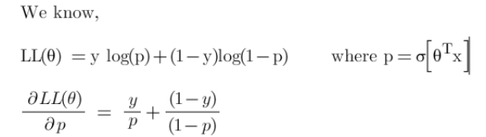
Derivation of Cost Function:
Now, we will derive the cost function with the help of the chain rule as it allows us to calculate complex partial derivatives by breaking them down.
Step-1: Use chain rule and break the partial derivative of log-likelihood.
Step-2: Find derivative of log-likelihood w.r.t p

Slide 35
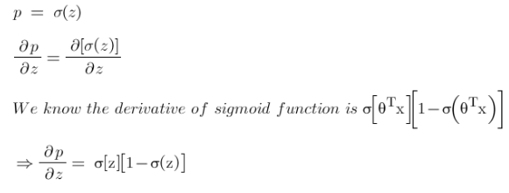
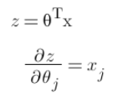
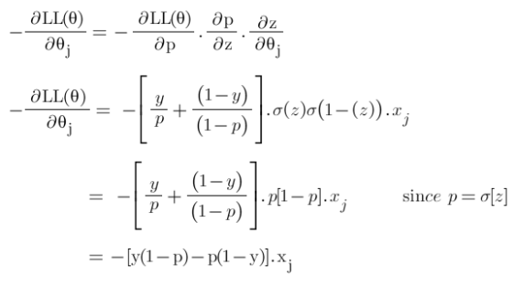
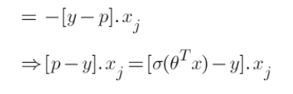
Step-3: Find derivative of ‘p’ w.r.t ‘z’
Step-4: Find derivate of z w.r.t θ
Step-5: Put all the derivatives in equation 1

Slide 36

Hence the derivative of our cost function is:
Now since we have our derivative of the cost function, we can write our gradient descent algorithm as:
If the slope is negative (downward slope) then our gradient descent will add some value to our new value of the parameter directing it towards the minimum point of the convex curve. Whereas if the slope is positive (upward slope) the gradient descent will minus some value to direct it towards the minimum point.

Slide 37
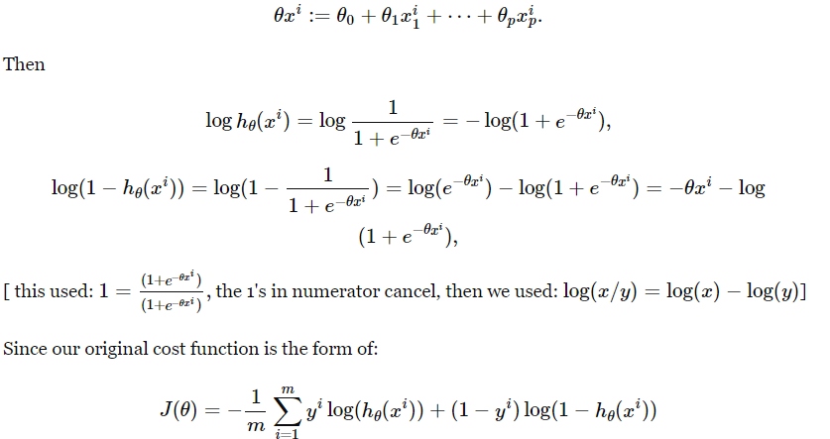

Slide 38
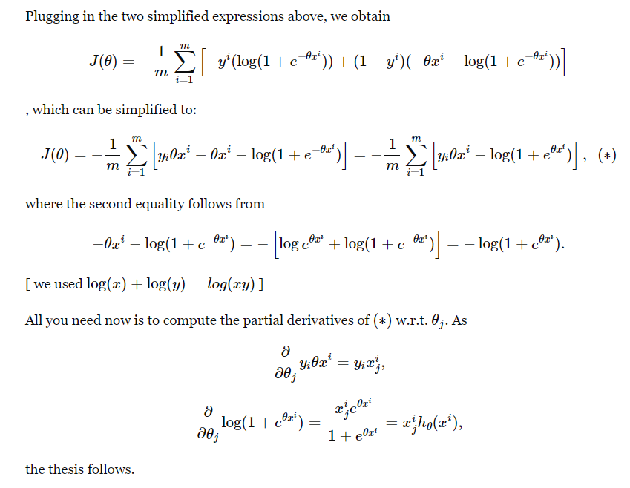

Slide 39
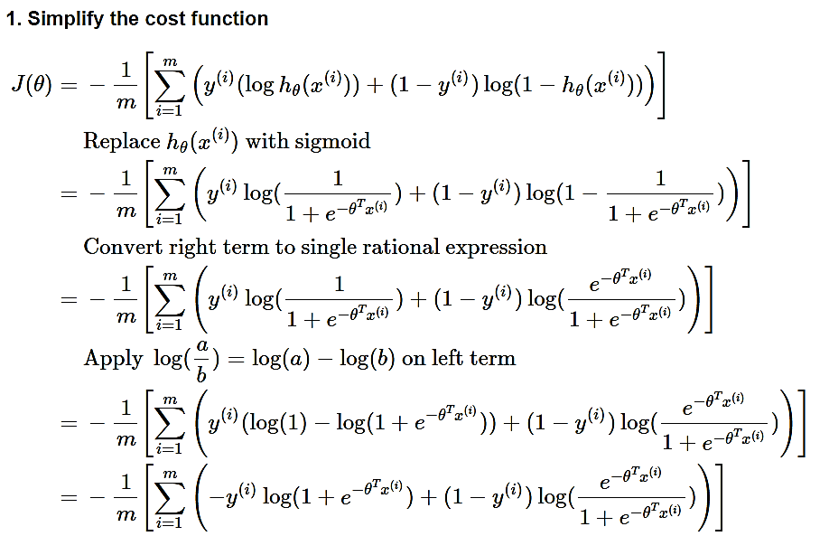
Deriving the Gradient Descent formula for Logistic Regression

Slide 40
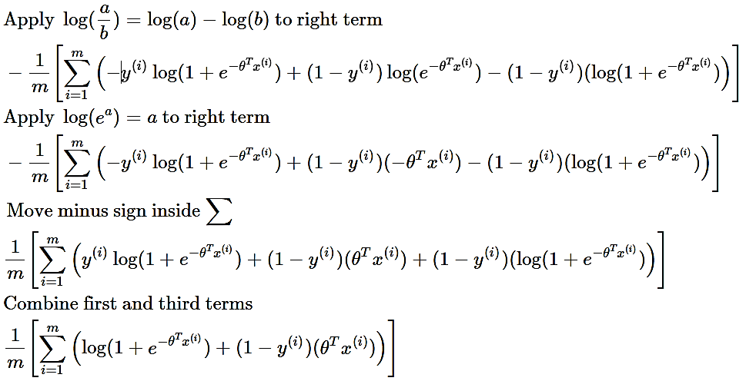
Deriving the Gradient Descent formula for Logistic Regression

Slide 41
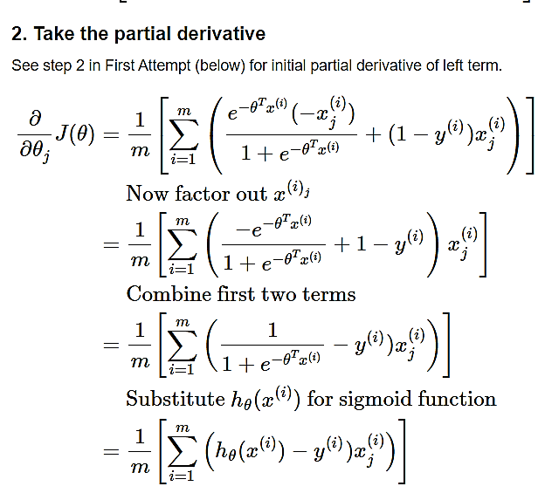
Deriving the Gradient Descent formula for Logistic Regression

Slide 42
How Does Gradient Descent Work?
Gradient descent is an optimization algorithm used to minimize the cost function of a model.
The cost function measures how well the model fits the training data and is defined based on the difference between the predicted and actual values.
The gradient of the cost function is the derivative with respect to the model’s parameters and points in the direction of the steepest ascent.
The algorithm starts with an initial set of parameters and updates them in small steps to minimize the cost function.
In each iteration of the algorithm, the gradient of the cost function with respect to each parameter is computed.
The gradient tells us the direction of the steepest ascent, and by moving in the opposite direction, we can find the direction of the steepest descent.
The size of the step is controlled by the learning rate, which determines how quickly the algorithm moves towards the minimum.
The process is repeated until the cost function converges to a minimum, indicating that the model has reached the optimal set of parameters.
There are different variations of gradient descent, including batch gradient descent, stochastic gradient descent, and mini-batch gradient descent, each with its own advantages and limitations.
Efficient implementation of gradient descent is essential for achieving good performance in machine learning tasks. The choice of the learning rate and the number of iterations can significantly impact the performance of the algorithm.

